Slide 1
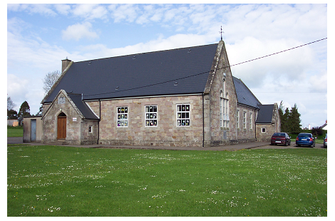
Monard N.S.
Open Day
28th April 2022

Slide 2
Our School Community
Ms. Mary O’Dwyer (Principal and Special Education Support Teacher)
Ms. Kathleen O’Shea (Deputy Principal / 3rd & 4th)
Ms. Áine Fitzgerald (Junior and Senior Infants. Currently on leave) Ms. Lorraine Peters is the substitute teacher.
Ms. Jean Heffernan (5th & 6th. Currently on leave) Mr. Padraic Hennessy is the substitute Teacher.
Ms. Claire Mullins (1st & 2nd)
Mrs. Betty Buckley (SNA)
Mrs. Shelly Carroll (SNA)
Mrs. L. O’Brien (Secretary)

Slide 3
General Information
Dept. of Education and Skills
Extra Activities ( GAA, soccer, Cycle safe, school garden, STEM, Bit Buzz, whizzkids, Music, Drama, grandparents day, science workshops, history talks, fire safety talks)
School Uniform / Tracksuit
Absence Guidelines
Code of Behaviour and Discipline
General Policies and
Covid 19 policy (on website)
Anti-Bullying Policy
School Finance

Slide 4
Code of Behaviour

Slide 5


Slide 6
Parental Permission Form

Slide 7
Parental Permission Form
Each year, we ask your permission for your child to participate in certain activities.
In order to cut down on unnecessary paperwork and simplify record-keeping, we have decided to include as
many permissions as possible on one sheet. Please read carefully each of the items below and tick the relevant box.
Not all items may be relevant to your child this year, but they probably will be at some stage in the future.
If you have any concerns regarding any of the items below please feel free to contact the class teacher or principal.
I hereby give permission for my child in relation to the following: | Yes | No
Do you give permission for your child to be photographed in school and at school events? These photos will be put up on the school website and the school blog.
Do you give permission for your child to attend the Learning Support teacher if the school deems it necessary?
Go on school tours, local educational visits/field trips and participate in school activities (e.g. concerts, quizzes, choir, sporting activities etc)
On occasions such as Communion, Confirmation and other school events, local press photographers take group photos of children and in some instances identify the children by name. Do you agree to the school using your child’s image in this way? (Please remember that removing a child from a photo of the rest of the class can be quite upsetting for the child).
The school is obliged to teach ‘Stay Safe’ lessons on personal safety & protection and RSE (Relationship & Sexual Education) lessons on developing and changing. Programmes taught are recommended and vetted by the Department of Education and Skills. Lessons are developed using suitable content and appropriate language for each class. Can your child participate in these lessons?

Slide 8
Do you give permission for your child to be taken immediately to a doctor or hospital in case of serious illness/accident? (In a non-emergency it is the school’s policy to inform parents/guardians if their child has had an accident in school which may require them to collect their child and take him/her home or to hospital or doctor). In an emergency it may be necessary to take the child to hospital/doctor and inform parents/guardians afterwards.
On occasion we administer ‘Diagnostic’ tests (e.g. Neale Analysis, MIST, BPVS, Belfield Infant Screening, NRIT, Dyslexia screening) to discover the educational progress of pupils. These tests may need to be administered on a one to one basis. Should any concerns arise following these tests we will contact you. Do you agree to this?
Name of Child: ____________________________________ Date: ________________
Class Teacher: ____________________________________
Name of Parent/Guardian: ____________________________________________
Signature of Parent/Guardian: ____________________________________________

Slide 9
Personal Insurance
Optional
24 hour cover
Medical expenses incurred from an accident may be claimed back on the insurance
Insurance forms and details will be available from the school in September

Slide 10
Healthy Eating

Slide 11








Healthy School Lunches
Guidelines
ENCOURAGE CHILDREN TO BRING LUNCHES THAT:
  Are high in fibre, low in fat, low in sugar and low in salt
  Provide a variety of foods from the food pyramid
  Do not contribute to tooth decay
  Help reduce litter in the school grounds
SUGGESTIONS FOR HEALTHY LUNCHES:
  Sandwich, roll, bread, crackers
  Fruit, vegetables
  Milk, water, soup, pure fruit juice
  Scones, plain buns (no icing), brack
  Yogurt, fromage frais, yogurt drinks
FOODS NOT RECOMMENDED:
    Sweets, bars, chocolate
    Fizzy drinks
    Biscuits
    Crisps
            Chips
              Sausage Rolls

Slide 12
Infant Curriculum
English
Irish
Maths
S.E.S.E.
S.P.H.E.
Music
Art
Drama
P.E.
Religion
Aistear

Slide 13
What is Aistear?
A curriculum framework for children up to six years old.
Describes the types of learning (e.g. values, attitudes, skills, knowledge and understanding) that are important in the early years.
Highlights the importance of play in children’s learning and development.
Integrated with the core curriculum

Slide 14
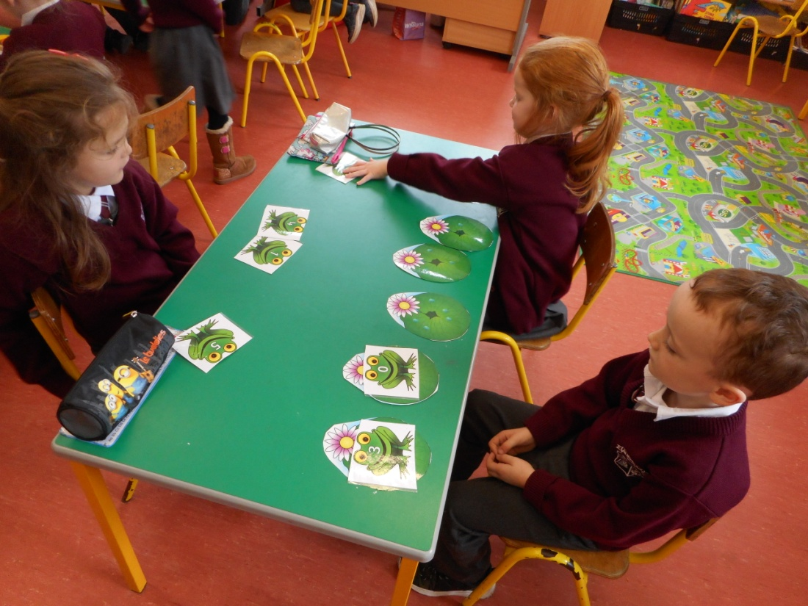
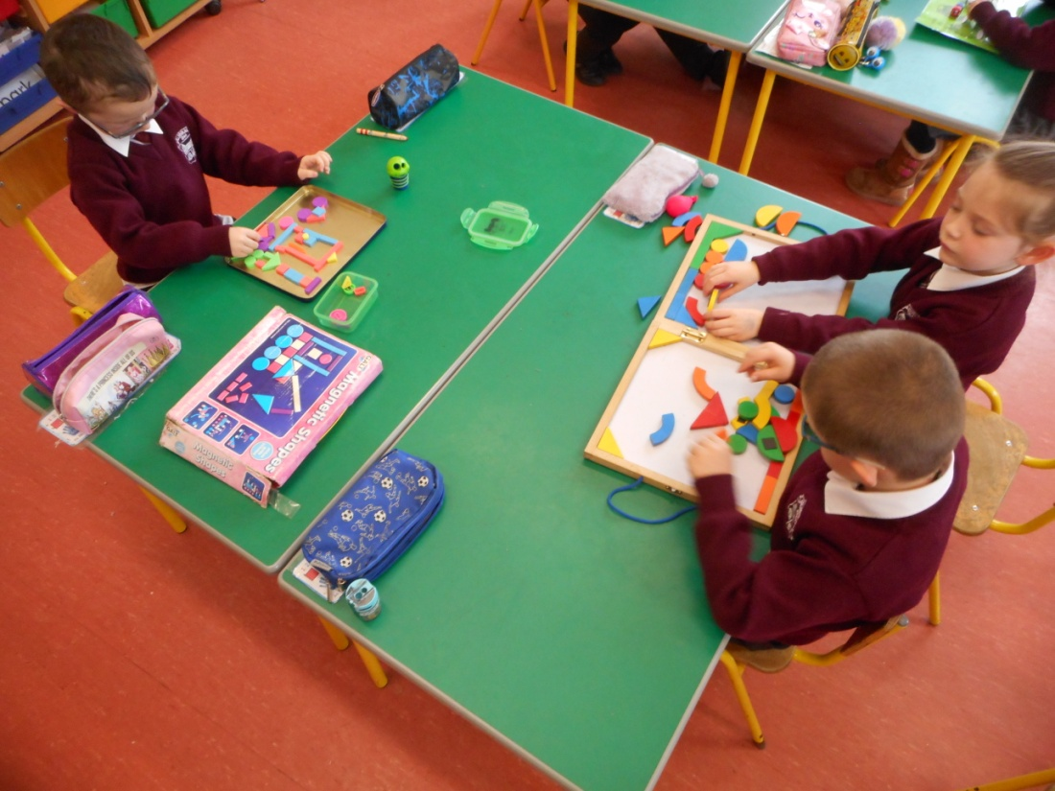
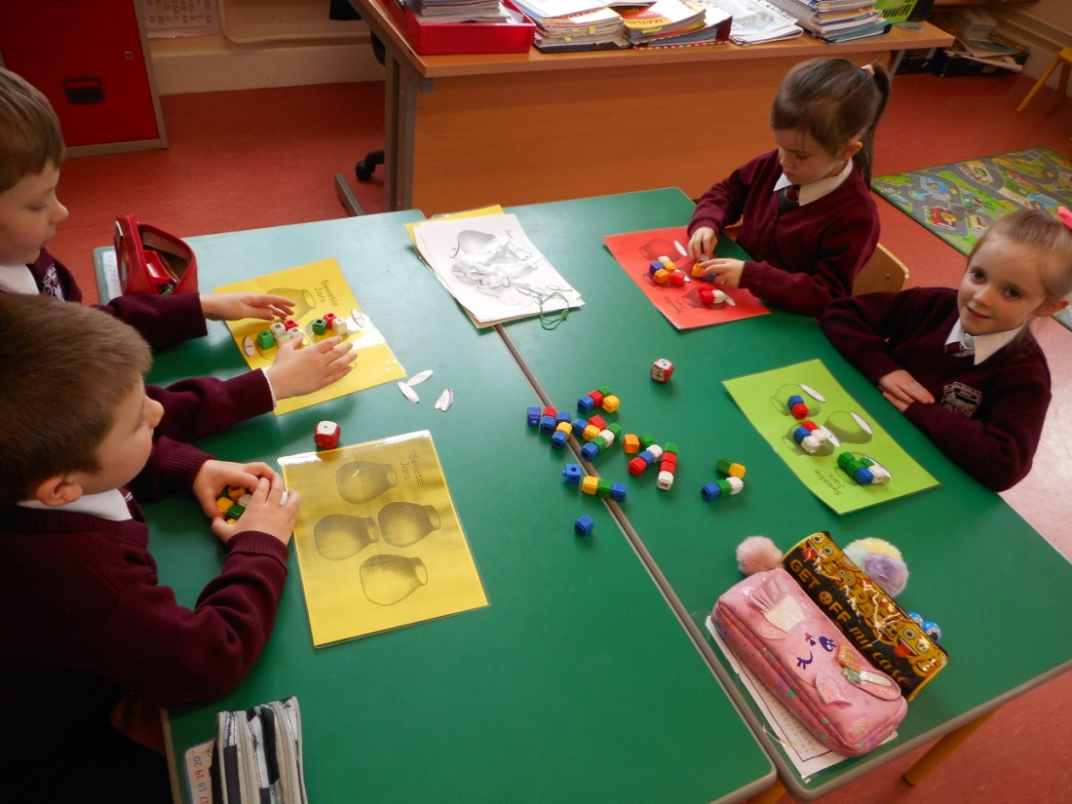
Maths
Early maths skills
Number
Algebra (patterns)
Shape and space (2D & 3D shapes/ positional language)
Measures (time, weight, capacity, length, height and money)
Data

Slide 15
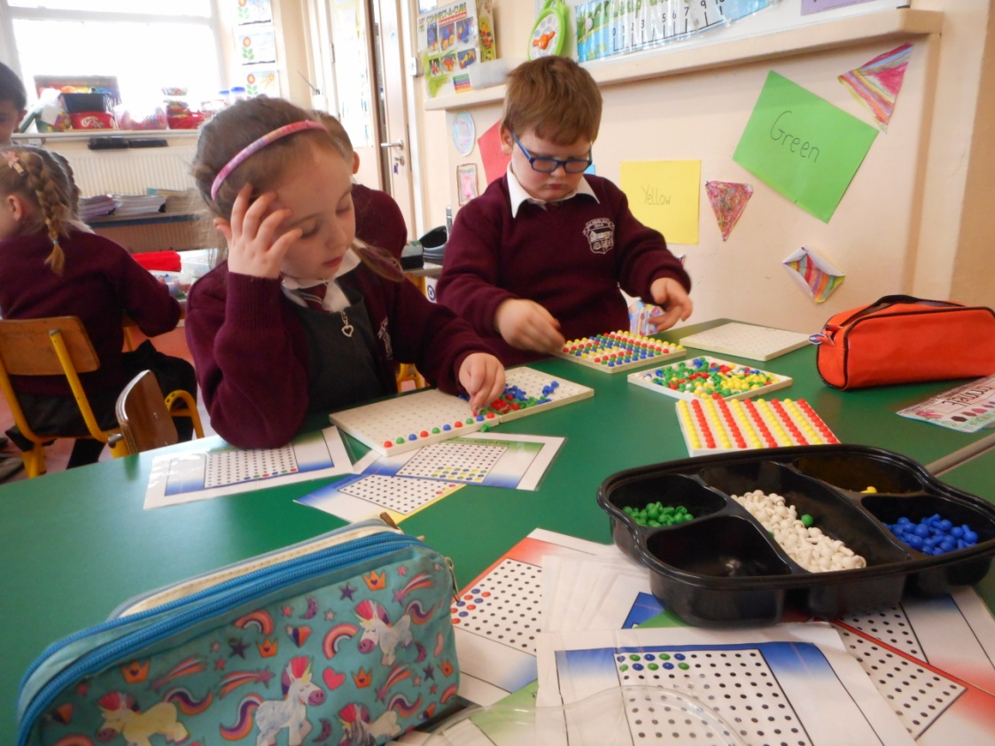
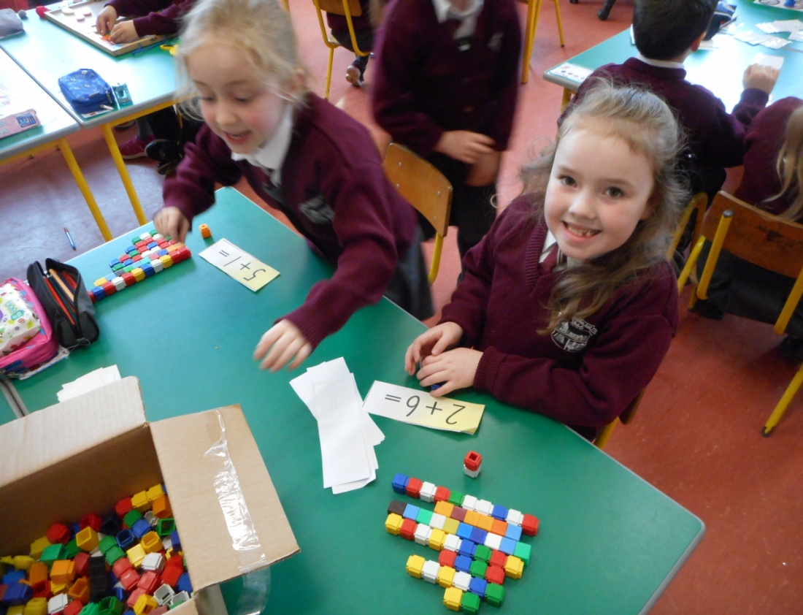
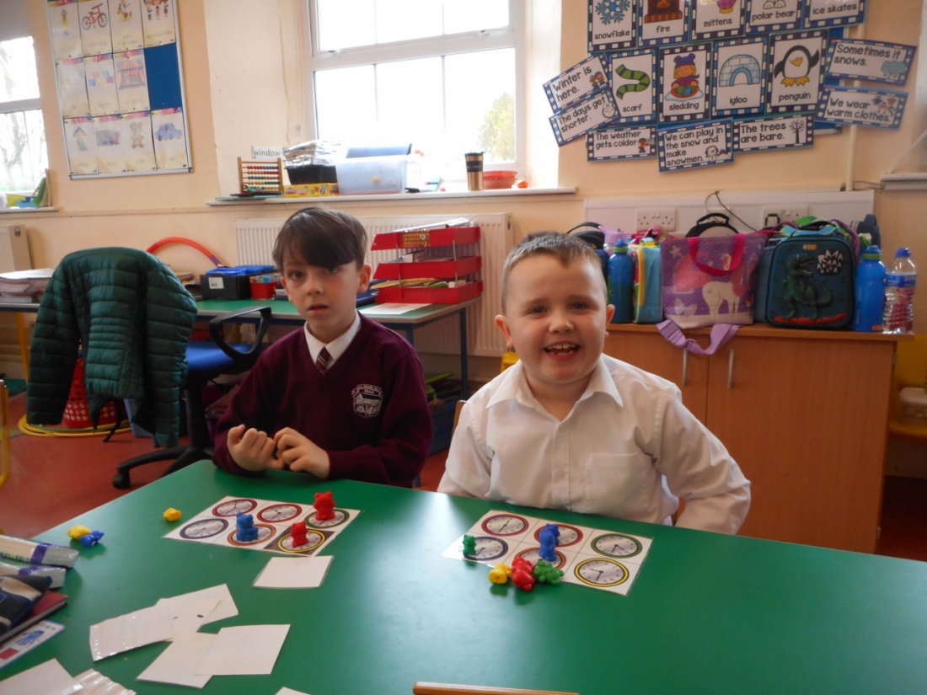
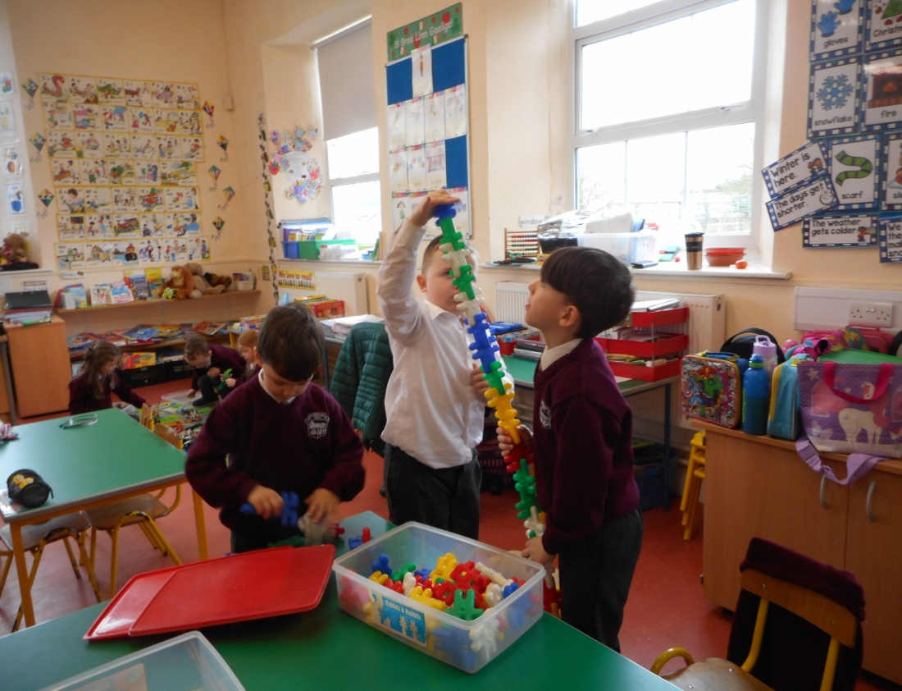

Slide 16
Infant School Day
9:20 am – 2:00pm
9:20am-12:00pm (First 2 weeks)
Arrival from 9:10am
Morning Break 11:00 am – 11:15am
Lunch 12:30pm – 1:00pm
Collection at 2:00pm

Slide 17
Homework
Monday to Thursday
Folder
Jolly Phonics
Pre-Writing / Writing
Shared Reading (September to December)
Formal Reading Scheme (January)
Grow in Love
Maths

Slide 18
General Requirements
Lunch-box and beaker
School bag
Morning Routine
Ensure all belongings are labelled
Book list

Slide 19
Sample Book list
Gaeilge
Céim ar Chéim A (CJ Fallon)
Maths
Busy at Maths Junior Infants (CJ Fallon)
English
Writing
Rainbow Skills Book A (CJ Fallon)
Sounds Like Phonics A (CJ Fallon)
Reading Zone Pre-Reading Activity Book (Folens)
Sight & Sounds Infant Book https://4schools.examcraftgroup.ie/
Ready, Steady Write A (Pre-Cursive) (Folens)
New Wave Pre-Writing Patterns (Prim-Ed)
SESE
Unlocking SESE Junior Infants (Folens)
Religion
Grow in Love Senior Infants Primary (Veritas)
All other books will be available on the Book Rental Scheme.

Slide 20
Junior Infant Requisites
Copy books:
2 x number 15
2 x blank
Art folder
1 x A3 plastic folder
Document folder 1 x A4 envelope folder
Homework folder
1 x zip folder
Writing requisites:
2 x junior grip triangular pencil
crayons, rubber & sharpener

Slide 21
Art apron with sleeves
100ml anti-bacterial hand gel
School Charges: Book Rental, Photocopying & Art supplies, Insurance (24 Hour Cover) Total due: €40
Voluntary Contribution: €75 per family.
Book Rental money to be paid on first day back in school. Books will be distributed as they are required.
Back to School on Friday, 26th August 2022
Please ensure that everything belonging to your child is labelled

Slide 22
Preparing for School

Slide 23
Preparing for School
You and Your Child
Open-Door Policy
Punctuality
School Notes
Text-a-Parent
Special Educational Needs

